Slide 1
BE
Barber Ease

Slide 2
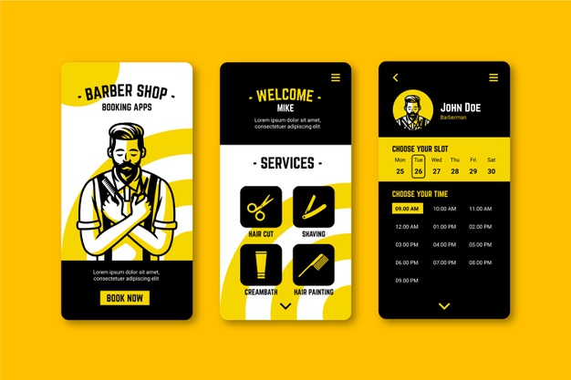

Slide 3




Members
Moamen Raafat Mohamed
Islam Ragab Ahmed
Abdullah Abdulmonem Ibrahim
Mohamed Hassan Abdelhakim

Slide 4
1) Introduction
2) Steps of solving
3) Database
Agenda
4) Mobile
5) Future Plan

Slide 5
01
Introduction

Slide 6
Introduction
The Barber Shop Management App is an innovative solution designed to revolutionize the grooming experience for both customers and salon owners. This user-friendly app simplifies appointment scheduling, payment processing, and service selection, allowing clients to book their favorite services with ease.
For barbers and salon owners, the app streamlines operations by providing tools for efficient scheduling, inventory management, and performance tracking. With features like appointment reminders and real-time notifications, the app ensures a seamless experience that enhances customer satisfaction.
Join us in transforming the way barber shops operate, making the grooming experience more convenient, efficient, and enjoyable for everyone involved.

Slide 7


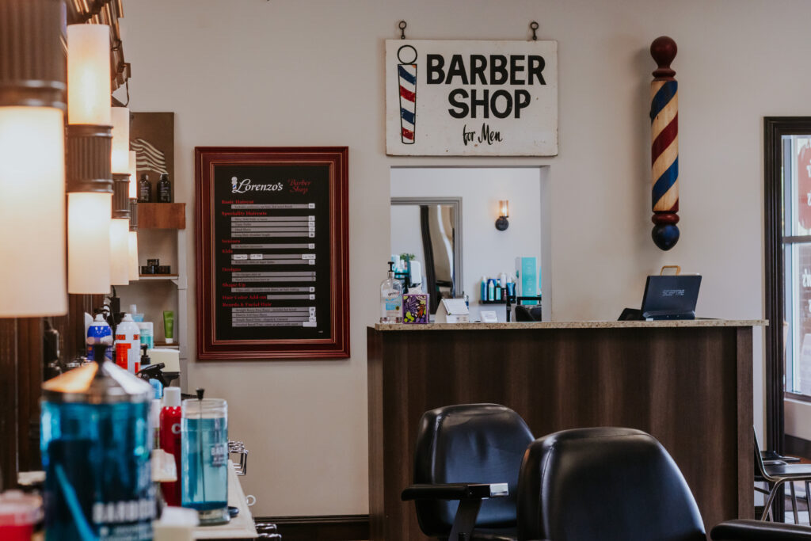
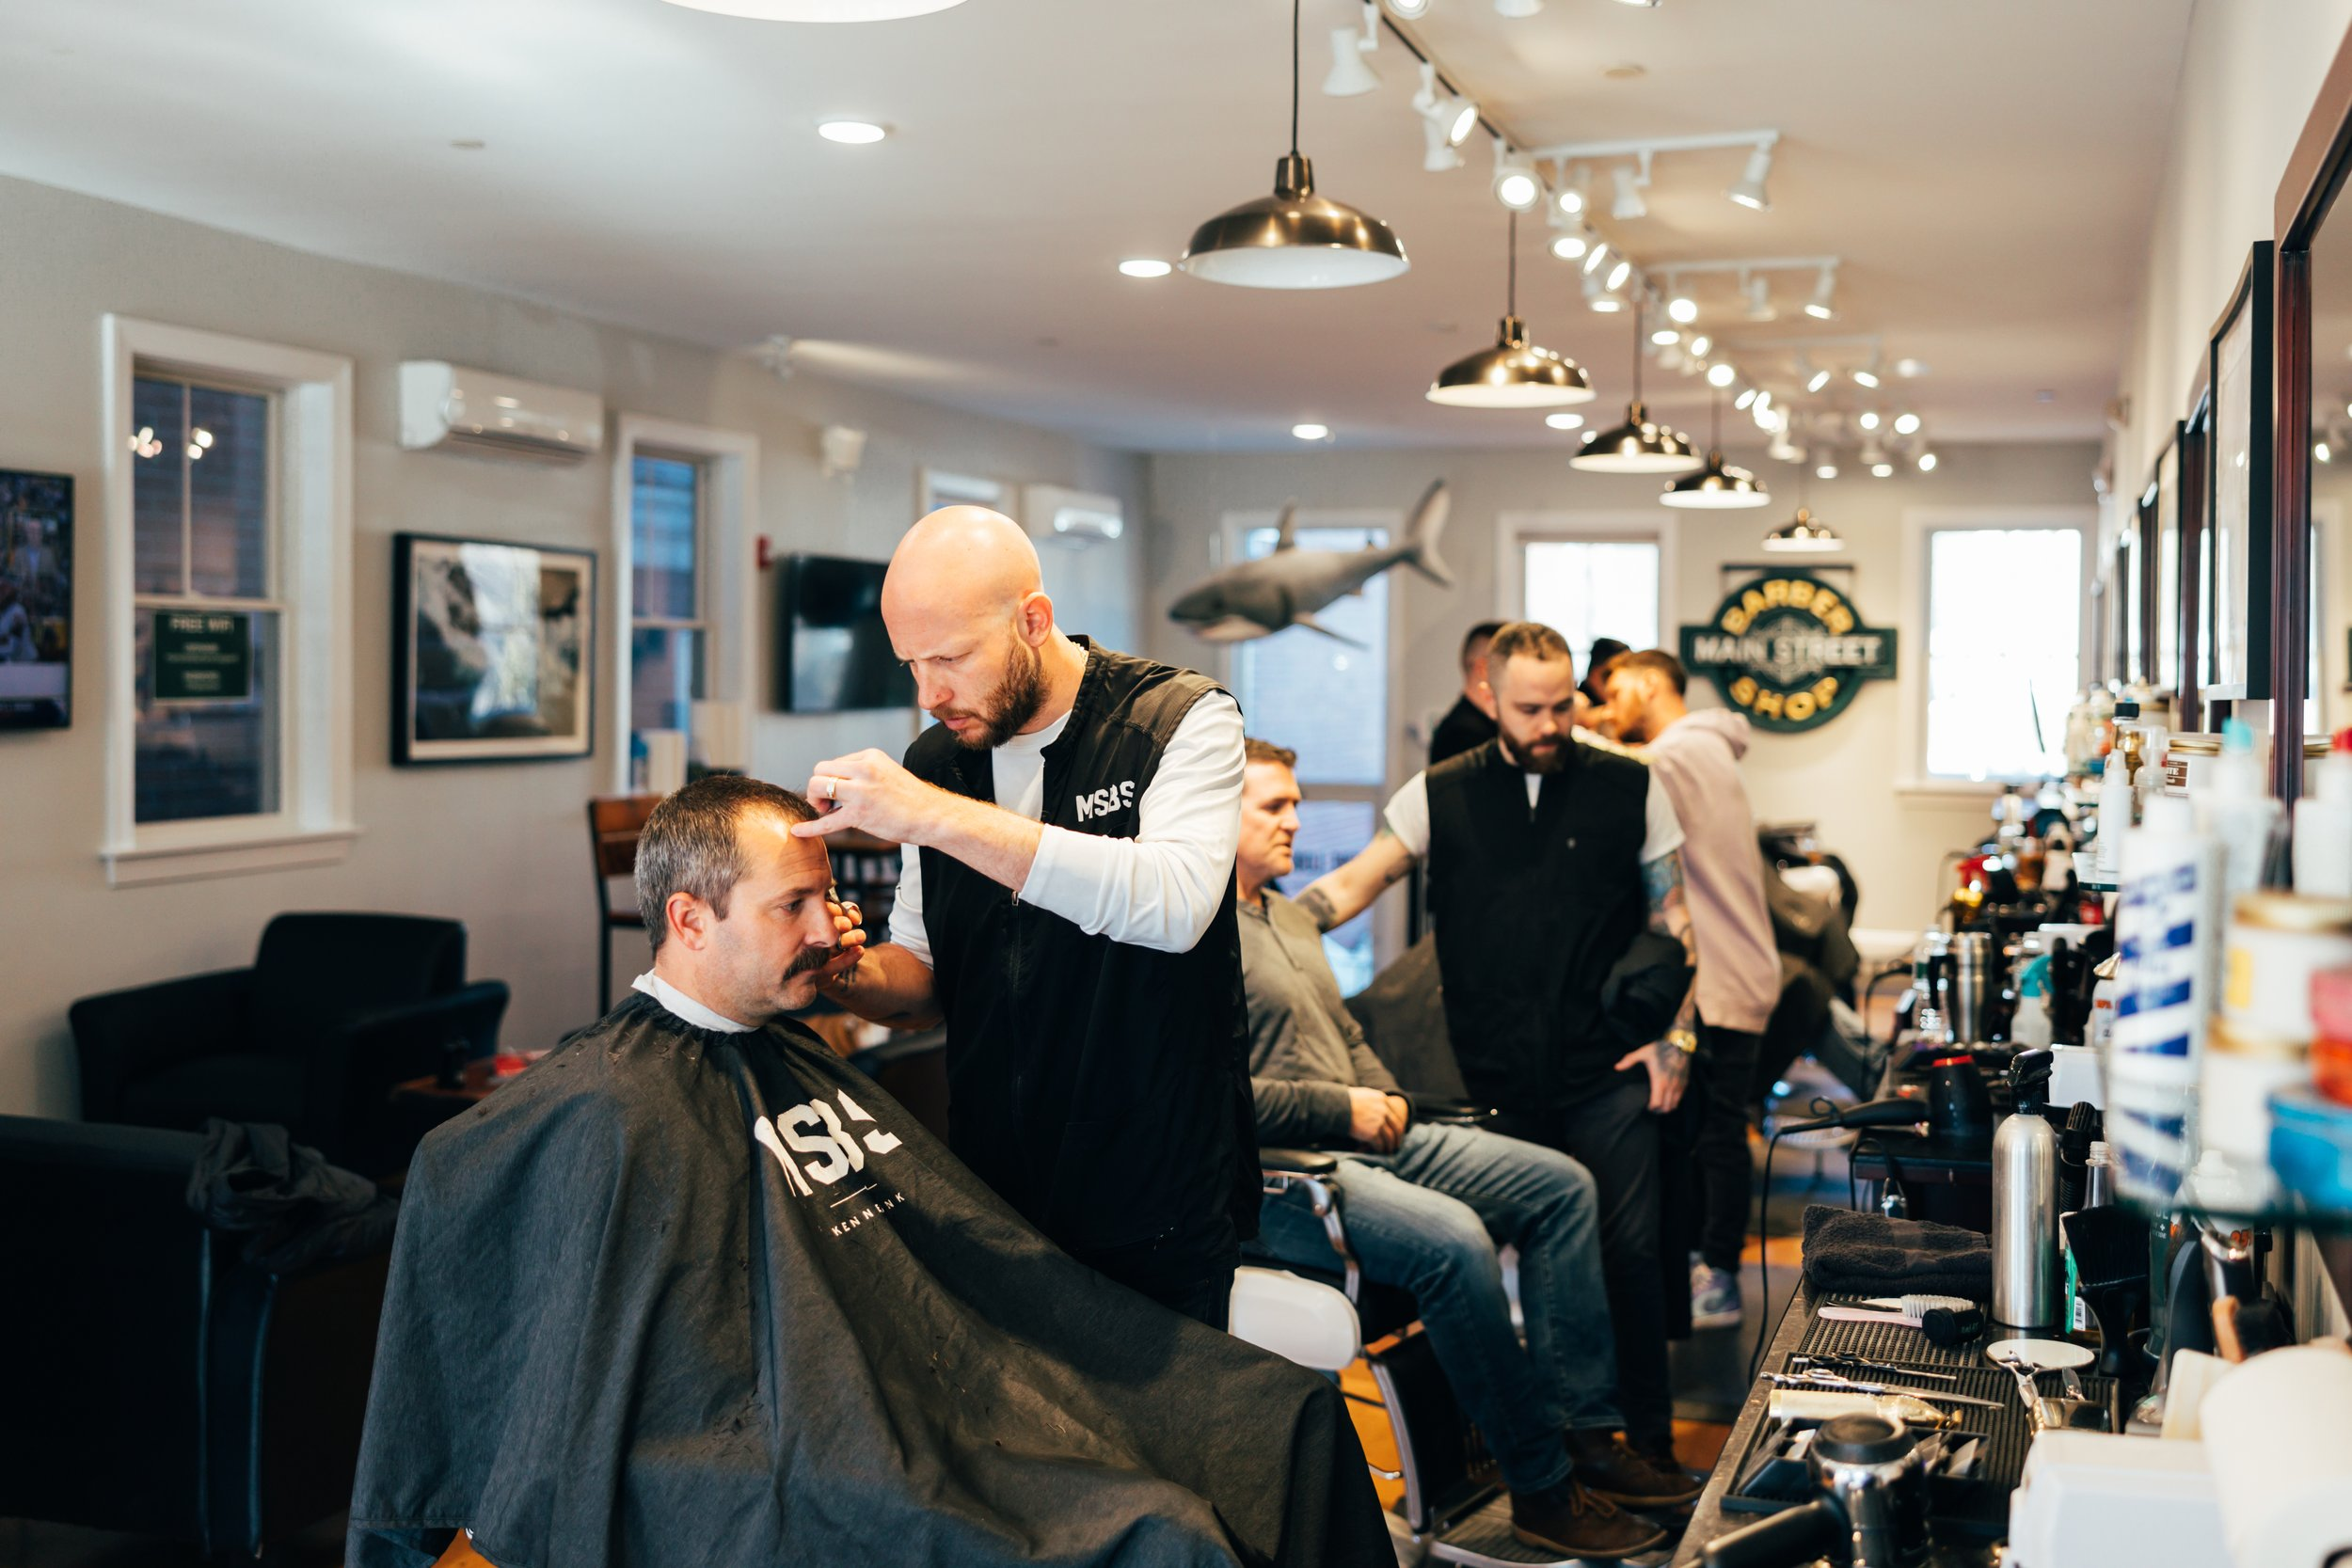
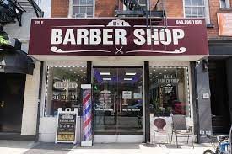
Problems
Difficulty in managing appointment schedules.
Missed appointments due to forgetfulness.
Difficulty finding the nearest salon location.
Limited payment options lead to inconvenience.

Slide 8




Objectives
Streamline Appointment Scheduling
Enhance Customer Experience
Streamline Appointment Scheduling,Enhance Customer Experience,Simplify Payments.
Simplify Payments.

Slide 9

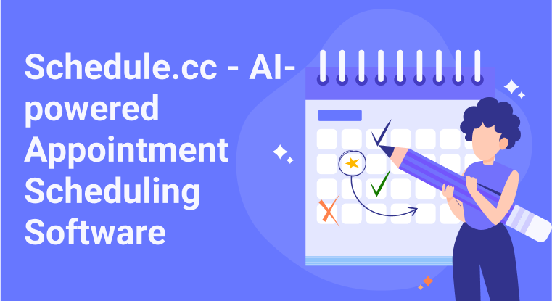
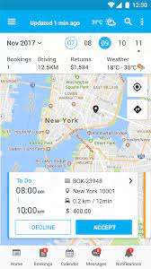
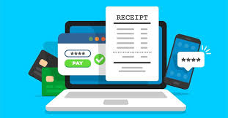
Difficulties
Complex Appointment Scheduling,Google Maps Integration,Online Payment Security

Slide 10
02
Steps of solving

Slide 11

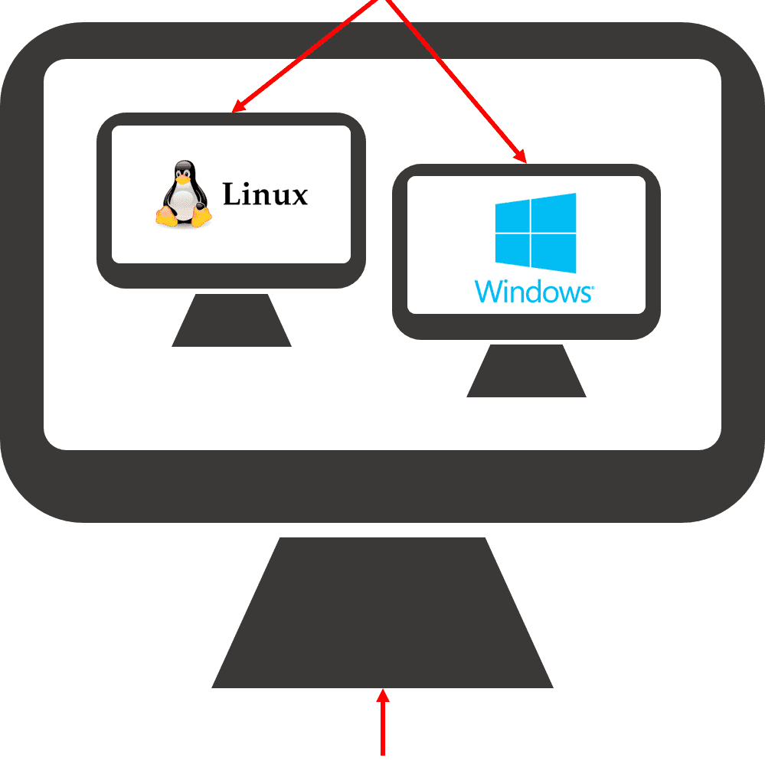
Steps:
Difficulty in Managing Appointment Schedules.
Missed Appointments Due to Forgetfulness.
Difficulty Finding the Nearest Salon Location.
Limited Payment Options Lead to Inconvenience.

Slide 12
2.1
Difficulty in Managing Appointment Schedules

Slide 13
Difficulty in Managing Appointment Schedules:
Step 1: Implement a real-time calendar and booking system that shows available time slots.
Step 2: Use a robust backend to handle overlapping or conflicting bookings, notifying users of potential conflicts.
Step 3: Integrate features like group bookings and automatic time zone adjustments for accuracy.

Slide 14
2.1
Missed Appointments Due to Forgetfulness

Slide 15
Missed Appointments Due to Forgetfulness
Step 1: Set up automated reminders via push notifications, SMS, or email using services like Firebase Cloud Messaging or Twilio.
Step 2: Customize the reminder timing, allowing users to set notifications an hour, a day, or a week before their appointment.
Step 3: Include a confirmation button in reminders so users can quickly confirm their attendance or reschedule.

Slide 16
2.3
Difficulty Finding the Nearest Salon Location

Slide 17
Difficulty Finding the Nearest Salon Location
Step 1: Integrate Google Maps API to display all salon locations relative to the user's current position.
Step 2: Add a "nearest salon" feature that shows the closest available location based on the user's GPS.
Step 3: Provide directions and estimated travel times within the app, helping clients easily navigate to the salon.

Slide 18
03
Database

Slide 19


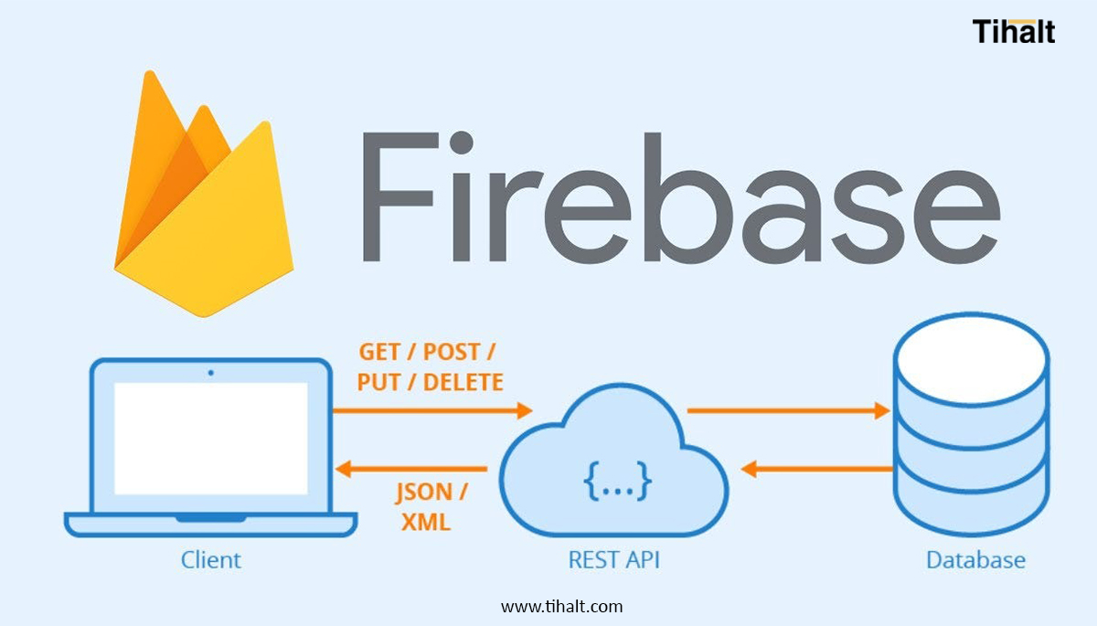
Database
A Database is an organized collection of data so that it can be easily accessed.
It helps to solve :
Loss of student’s data.
Data Manipulating.

Slide 20
04
Mobile

Slide 21
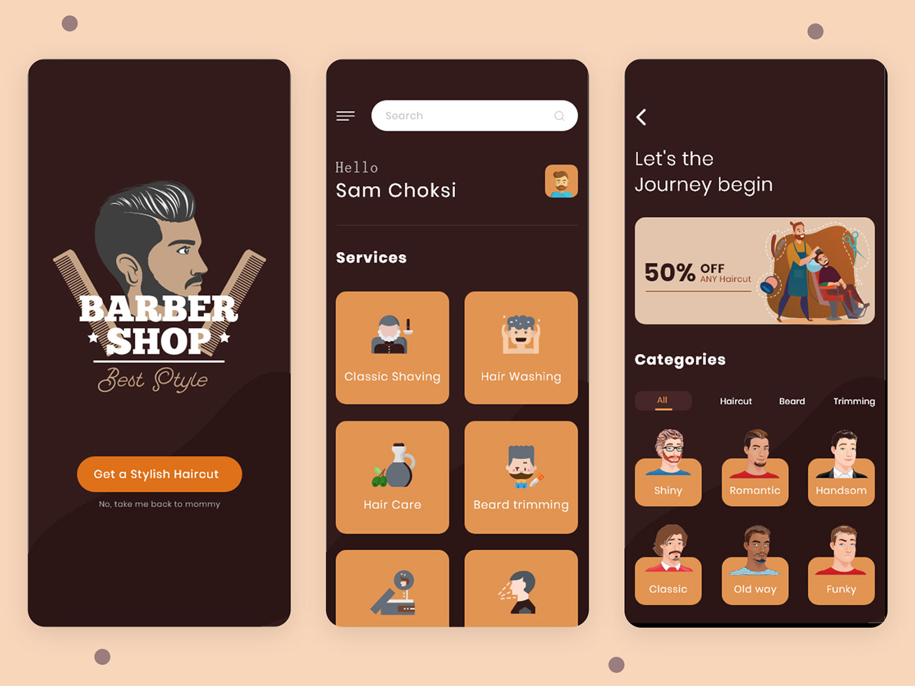
Mobile
It solves problems:
Appointment Scheduling and Missed Appointments:Loss of student’s data.
Difficulty Finding the Nearest Salon.
Limited Payment Options.

Slide 22
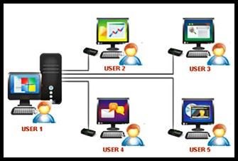
System Users:
System Administrator:
Technical personnel responsible for maintaining the app’s backend, database, and security.
Barbers:
Salon staff who perform services and manage their schedules through the app.
Customers:
Individuals who use the app to book appointments, choose services, make payments, and provide feedback.

Slide 23
Future Plan

Slide 24
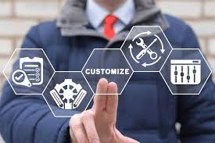
Feature Expansion:
Service Customization: Allow clients to create personalized service packages based on their preferences and past bookings.

Slide 25

Integration with Other Services
Social Media Integration: Enable clients to share their new looks or reviews on social media platforms directly from the app.

Slide 26

Mobile Application
Using flutter to resolve website into mobile app.
Github

